Slide 1

Tracking: Optical Techniques
CS 498VR: Virtual Reality
UNIVERSITY OF ILLINOIS AT URBANA-CHAMPAIGN
Based on material from: Gordon Wetzstein, Stanford University
Eric Shaffer

Slide 2
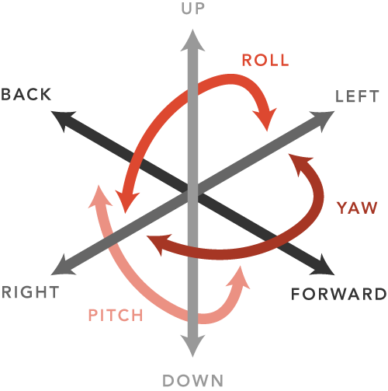
Tracking Position and Orientation
Now we will discuss tracking all 6 DOFs for a moving rigid body
We call the position + orientation the pose
Why track? To map user movement into the virtual environment.

Slide 3
Overview of Positional Tracking
“inside-out tracking”: camera or sensor is located on HMD, no need for other external devices to do tracking
simultaneous localization and mapping (SLAM)
computer & robotic vision problem (beyond this class)
“outside-in tracking”: external sensors, cameras, or markers are required (i.e. tracking constrained to specific area)
used by many slightly older HMDs (Rift and Vive)

Slide 4

Integrate the Accelerometer?
We could subtract off acceleration due to gravity and find body acceleration…
What do we need to estimate position?
How does that contrast with using a gyroscope to compute orientation?
What is effect on the error?
Can the IMU sensors be used to correct positional drift error?

Slide 5
Integrate the Accelerometer?
What do we need to estimate position? Integrate twice
How does that contrast with using a gyroscope to compute orientation? Only a single integration is necessary to find orientation from angular velocity
What is effect on the error? It’s significantly worse when integrating twice
Can the IMU sensors be used to correct positional drift error? No…can’t detect even constant velocity

Slide 6
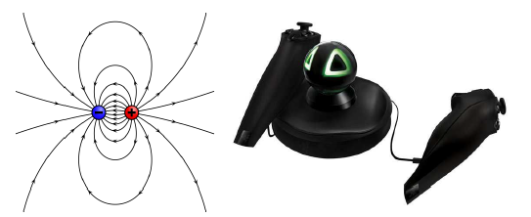
Active Tracking
Another approach is to create a signal to be sensed
Many approaches have been tried
Infrared
Ultrasound
Electromagnetic

Slide 7
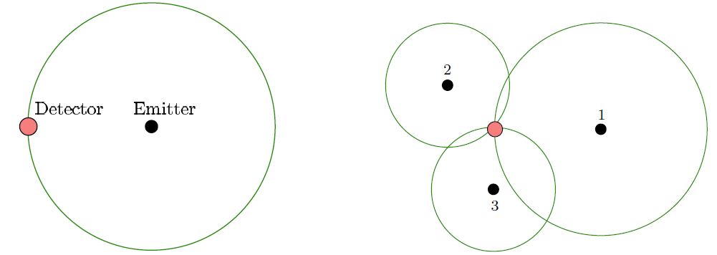
Trilateration
Consider something like ultrasound
Emitter is a speaker and detector is a microphone
Speaker emits at known time intervals…
Time of Flight (time to detection) enables computation of distance
Three emitters allow unique determination of location…

Slide 8
Sound and EM…and Visibility
Both kinds of systems have been problematic
Sound reflects off objects in the rooms leading multiple detections
Environment can warp EM fields and thus warp detected trajectories
Visibility approaches have been more robust
Camera can be used to track features
Oculus Rift system tracks infrared LEDs on the HMD

Slide 9
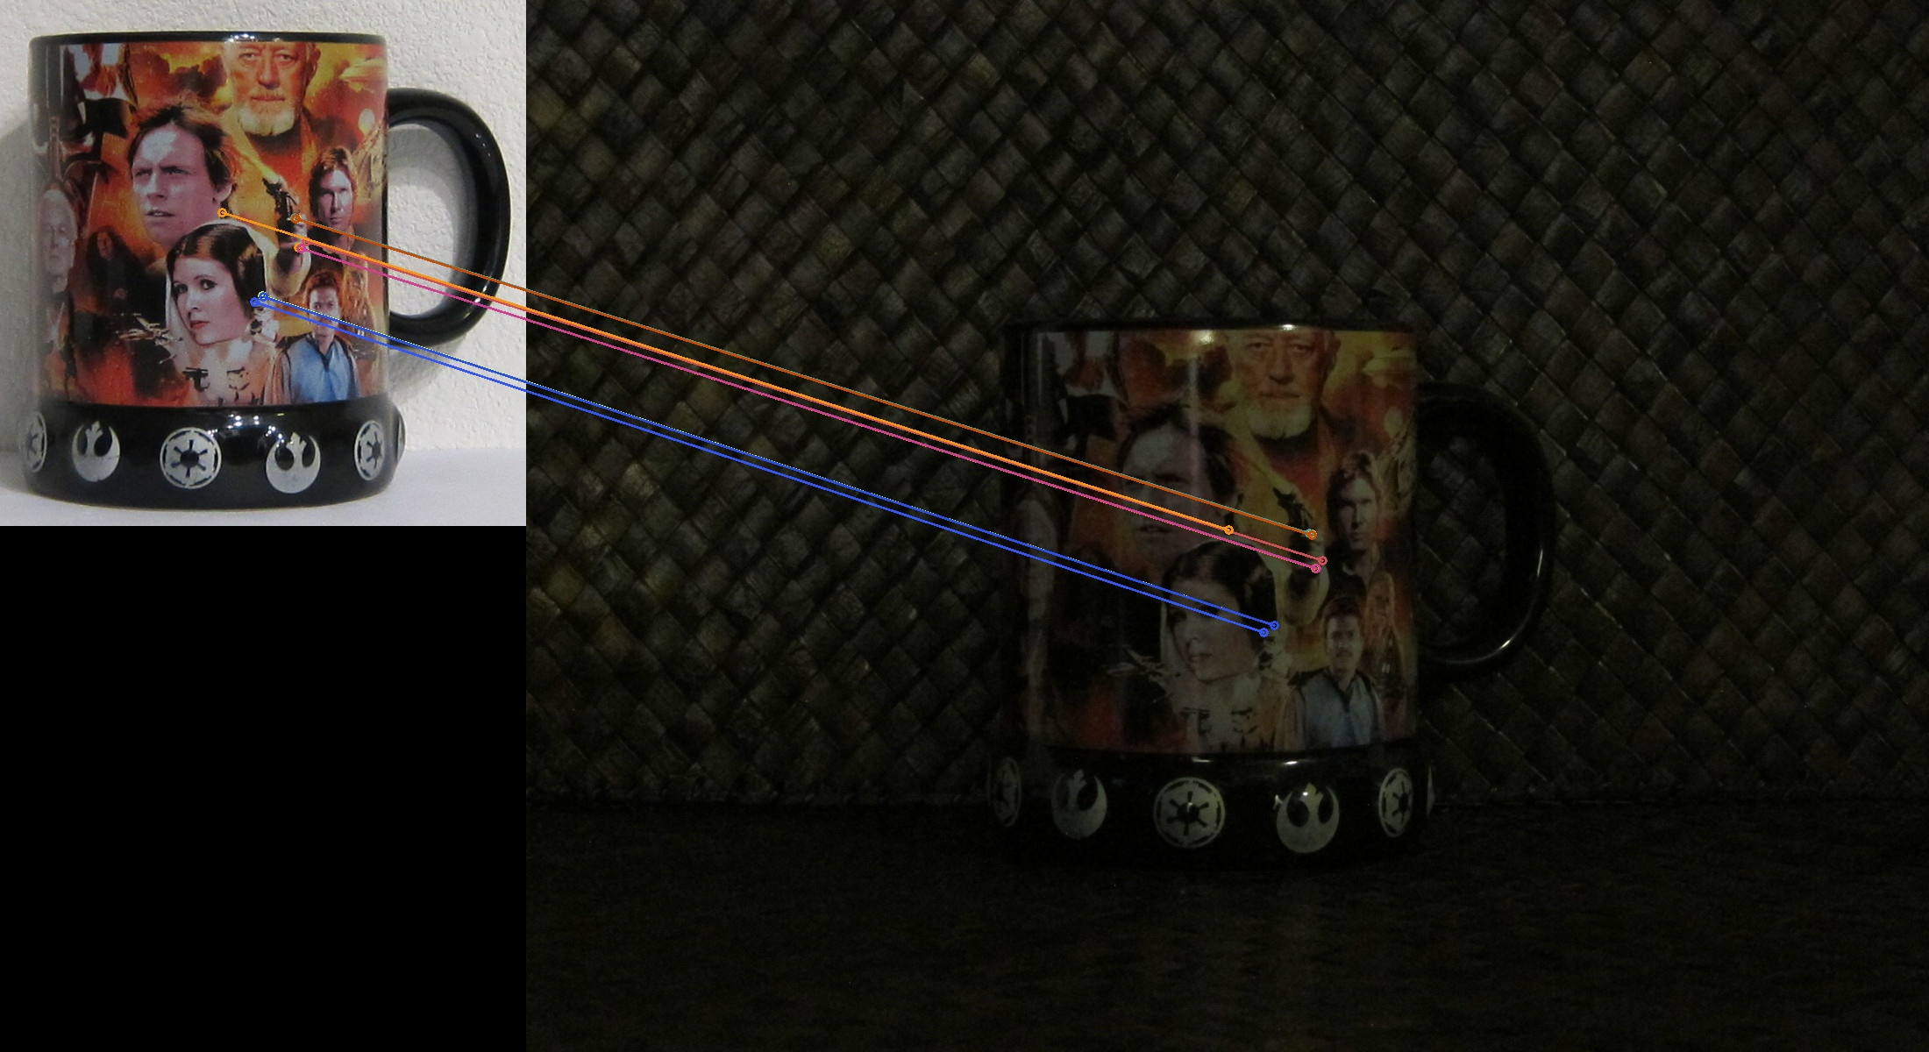
A Quick Guide to Features
Natural Features: Automatically discovered and labeled
Artificial Features: Engineered and placed in scene with assigned labels
Passive Features: Do not emit energy…can reflect energy (i.e. light)
Active Features: Emit light

Slide 10
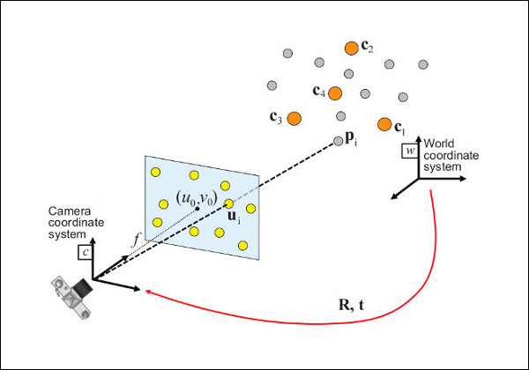
Perspective-n-Point Problem (PnP)
Using n-points on an object in an image, compute the pose matrix T_{rb}
Each observed point (i,j) in image coordinates eliminates 2 DOFs
For 3 points (i.e. P3P) 0 DOFs remain but solution is not unique
P6P required for unique solution
More than 6 points generally used to make solution robust to error
Remember: We are computing the pose of the camera

Slide 11
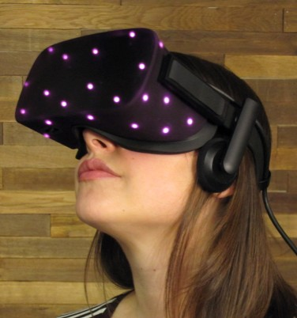

Positional Tracking - Optical
track active (near IR) LEDs with cameras
OR
track passive retro-reflectors with IR illumination around camera
Oculus Rift
https://www.ifixit.com/Teardown/
Oculus+Rift+CV1+Teardown/60612
both Oculus Rift and HTC Vive come with optical tracking

Slide 12
HTC Lighthouse
Lighthouse HTC Vive tracking is an example
Lighthouse has spinning drum emitting vertical and horizontal IR light
Photodiodes on HMD detect IR light

Slide 13
HTC Lighthouse

Slide 14
HTC Lighthouse
Bright IR flash followed by 2 sweeps of IR light
Horizontal light determines column of feature coordinate
Vertical light determines row of feature coordinates Time delay from flash reflection to sweep reflection is recorded by HMD photodiodes
Multiple base stations needed to compute distance from feature to station

Slide 15
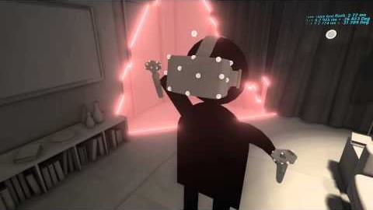
Example: HTC Lighthouse

Slide 16



















Understanding Pose Estimation
For pose estimation, need to track multiple points with known relative 3D coordinates
2D
projections
Estimating 6-DoF pose from 2D projections is known as the
Perspective-n-point problem!

Slide 17
Image Formation
Map 3D points in object coordinate system to 2D points in window coordinates
With the Vive Lighthouse, the IR light sweeps allow the Vive to generate 2D “image points” associated with each photodiode on the Vive…

Slide 18
Finding Pose: Use a Familiar Camera Model

Slide 19
The Homography Matrix
We want to find the Homography matrix H…that will ultimately give us a pose

Slide 20
Finding Pose: Linear Homography Method
Homography matrix has 8 degrees of freedom
Any scaled version of the matrix can be used…get the same result

Slide 21
Scaling the Homography Matrix
So…estimate a scaled version of the matrix where h₉ = 1

Slide 22
Image Formation with Scaled Matrix

Slide 23
Reorganize the Equation

Slide 24
Need a System of Equations

Slide 25
Use 4 Marker Points...Solve System

Slide 26
Need to Find Scale….

Slide 27
Compute the Position

Slide 28
Get Rotation

Slide 29
Temporal Filter to Smooth Noise
pose estimation is very sensitive to noise in the measured 2D coordinates!
→ estimated position and especially rotation may be noisy
apply a simple temporal filter with weight α to smooth the pose at time step k:
( ) ( )
(k− )
( )
(k )
θ ,θ ,θ ,t ,t ,t
( k )
= α θ ,θ ,θ ,t ,t ,t
1
( )
+ 1 − α θ
,θ ,θ ,t ,t ,t
x y z x y z
filtered
x y z x y z
filtered
x y z x y z
unfiltered
smaller α → less filtering, larger α → more smoothing

Slide 30
Pose Estimation via Homographies – Step-by-Step
in each loop() call of the VRduino:
get timings from all 4 photodiodes in “ticks”
convert “ticks” to degrees and then to 2D coordinates on plane
at unit distance (i.e. get x^{n} , y^{n} )
i i
populate matrix A using the 2D and 3D point coordinates
estimate homography as h=A⁻¹b
get position t_{x}, t_{y}, t_{z} and rotation, e.g. in Euler angles from the estimated homography
6. apply temporal filter to smooth out noise

Slide 31
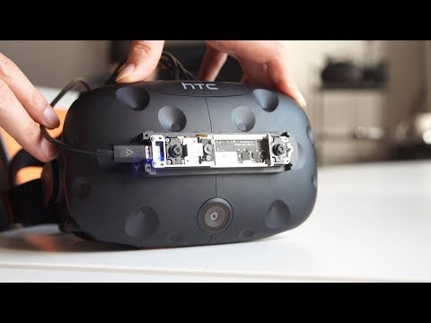
Inside-Out Tracking

Slide 32

Oculus Quest

